Slide 1


Slide 2

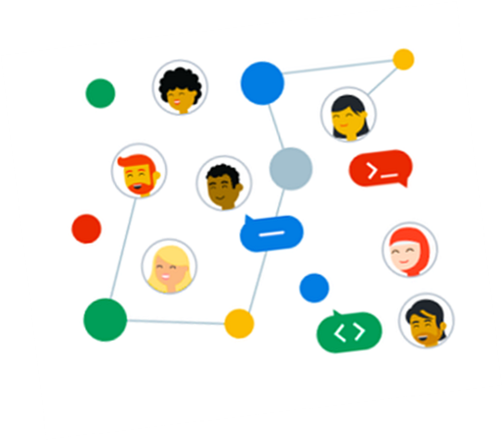
Welcome to Inauguration of GDSC(2023)
Echelon Institute of Technology

Slide 3


Slide 4
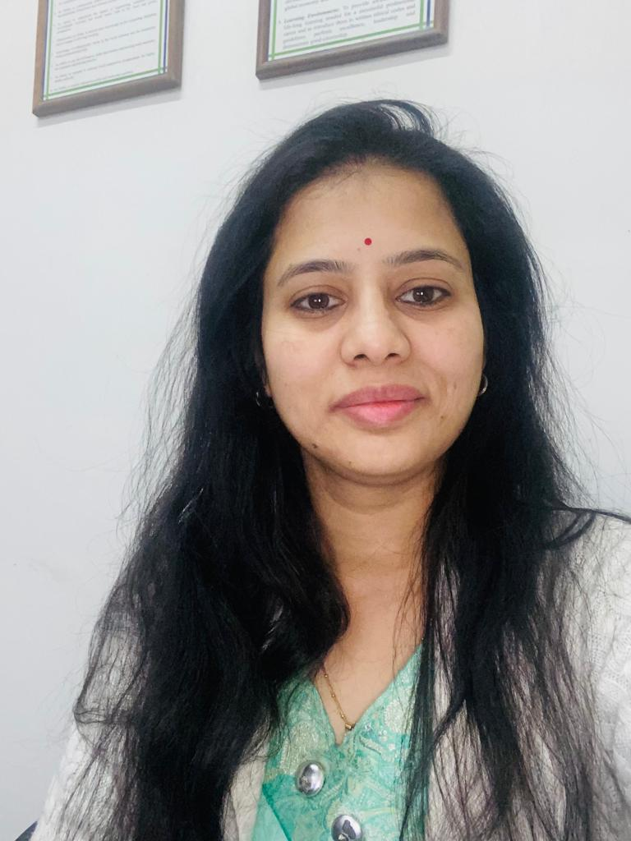
->Btech Mtech PhD (pur).
->12 years of teaching experience in various colleges.
->4 papers were published at international conferences. One book named Open Source Technology was published in the year 2009 (Ed 1 & 2).
Area of expertise DBMS, ML
Ms. Stuti Saxena Assistant Professor CSE

Slide 5

Presenting you our GDSC Lead
Sahil Ali NLP Intern at Microsoft
2023-2024

Slide 6

What is GDSC?
Google Developer Student Clubs (GDSC) are university groups for students interested in Google Technologies and programming. There are Google Developer Student Clubs in over 110 countries around the world that include undergraduate and graduate students. GDSC members teach each other about ML, Android App Development, Google Cloud , Flutter and other exciting technologies.

Slide 7
🡪 By joining a GDSC, students grow their knowledge in a peer-to-peer learning environment and build solutions for local businesses and their community. 🡪 The Google Developer Student Clubs (GDSC) program aims to empower student developers in universities to impact their student communities. 🡪 It aims for university students to help them build their mobile web applications, Machine learning, Cloud skills etc.
Aim

Slide 8
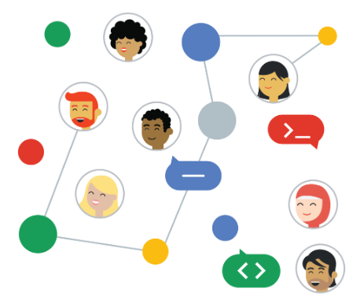
GDSC have successfully built their communities and engaged members to learn and share best practices with each other. Android study Jams, hosted by Google Developer Students Clubs (GDSC) chapters across the globe and in India ,leverage peer-to-peer teaching to train a new generation of student android developers.
Global Impact of GDSC

Slide 9
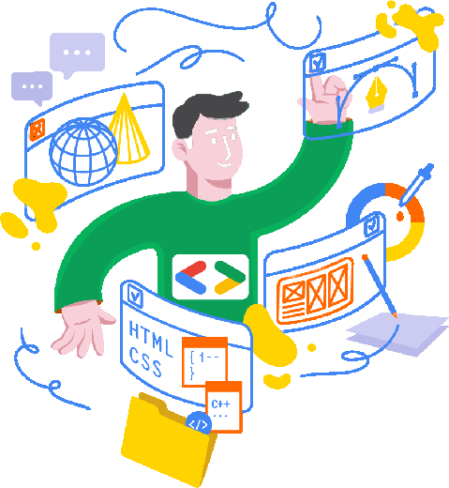
🡪 Exposure to new Technology 🡪 Enriches Student Life 🡪 Networking 🡪 Working with the team
What’s for me ?

Slide 10
GDSC Members Benefits
Learn in Collaborative Environment Common Place to Clean your doubts
Earning Certificates and Recognition

Slide 11
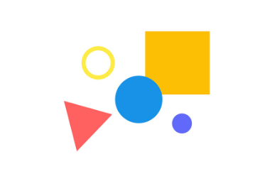

React.js
React.js application in real world :
Ease of use .
The virtual dom.
Open source.
Development tool e.g Reactide, Evergreen jest.

Slide 12

React.JS has been selected by thousands of businesses worldwide. Companies like:-
1) Walmart Labs
2) Netflix
3)Tesla
4) PayPal
5)Drop box

Slide 13
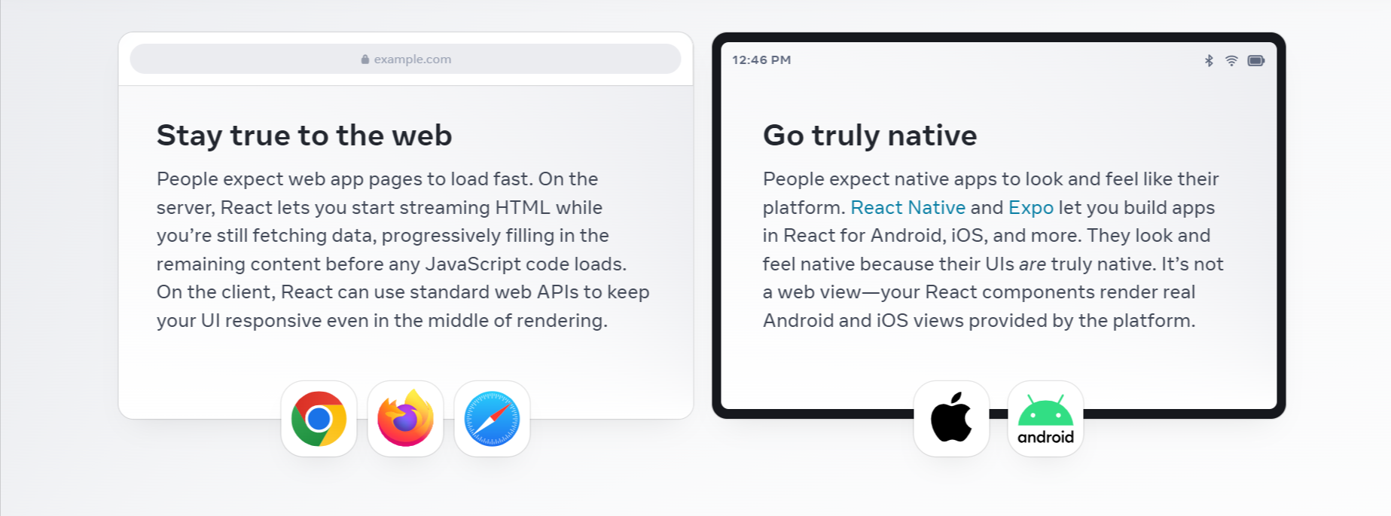
People love web and native apps for different reasons. React lets you build both web apps and native apps using the same skills. It leans upon each platform’s unique strengths to let your interfaces feel just right on every platform.

Slide 14
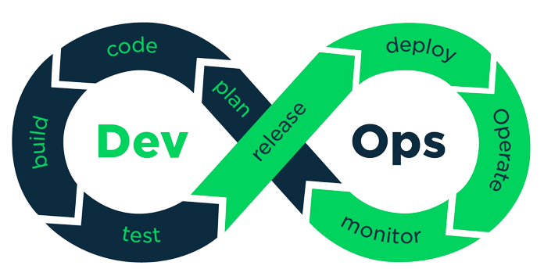
Dev Ops
DevOps is a modern software development methodology that combines development (Dev) and operations (Ops) teams to streamline the entire software delivery lifecycle.
DevOps aims to shorten development cycles, increase deployment frequency, and enhance software quality.
DevOps aims to bridge the gap between development and operations, promoting a more efficient, reliable, and agile software development process.

Slide 15
DEVOPS FLOW
TEAMS
UNIT TESTING
INTEGRATION TESTINGI
SYSTEM TESTING
team 1
dev ops
BUILD
INTEGRATION
team 2 dev ops
BUILD
INTEGRATION
DELIVERY
DEPLOYMENT
ACCEPTANCE TESTING
INTEGRATION
SOFTWARE
SOFTWARE PACKAGE
team 3 dev ops
BUILD
SOFTWARE COMPONENTS

Slide 16

The new way to Cloud Starts here

Slide 17
Google Cloud
The databases and software located and access over the internet is are refers as cloud. Cloud servers are located in data centres all over the world.
Ex: google cloud, azure,aws (images )
Types of cloud
Public Cloud
Private Cloud
Hybrid Cloud
Community Cloud

Slide 18
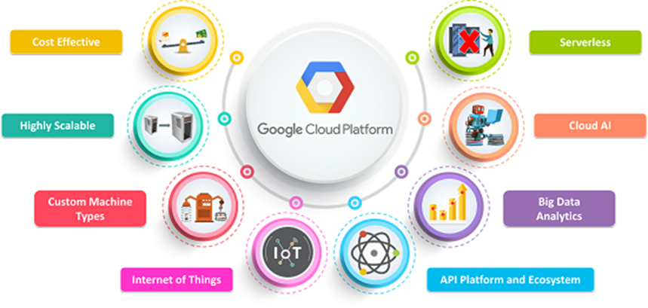

Slide 19


Develop Android apps with Kotlin

Slide 20


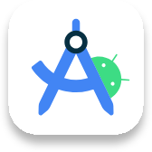
Expressive and concise
Kotlin's modern language features allow you to focus on expressing your ideas and write less boilerplate code.
Safer code
With nullability included in its type system, Kotlin helps you avoid NullPointerExceptions. Android apps that use Kotlin are 20% less likely to crash.
Android Studio
provides first-class support for Kotlin. It even has built-in tools to help you convert Java-based code to Kotlin.

Slide 21
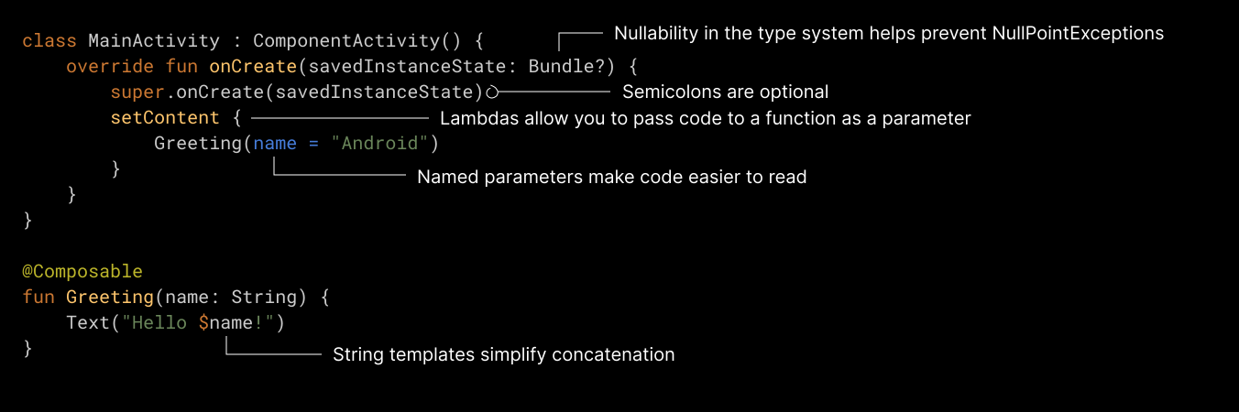

Slide 22
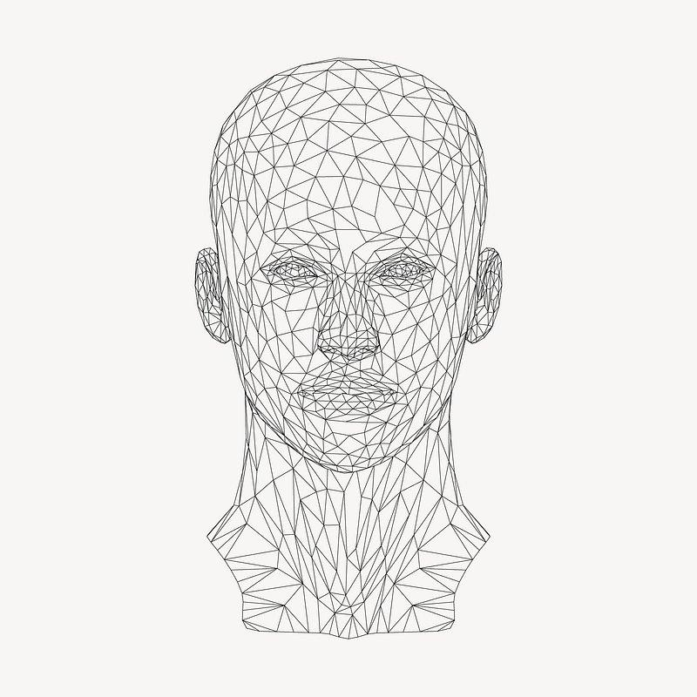
Introduction to AI
Artificial intelligence is the simulation of human intelligence processes by machines, especially computer systems.

Slide 23
Types of AI
AI
Deep Learning
Narrow AI
General AI
NLP
Machine Learning

Slide 24
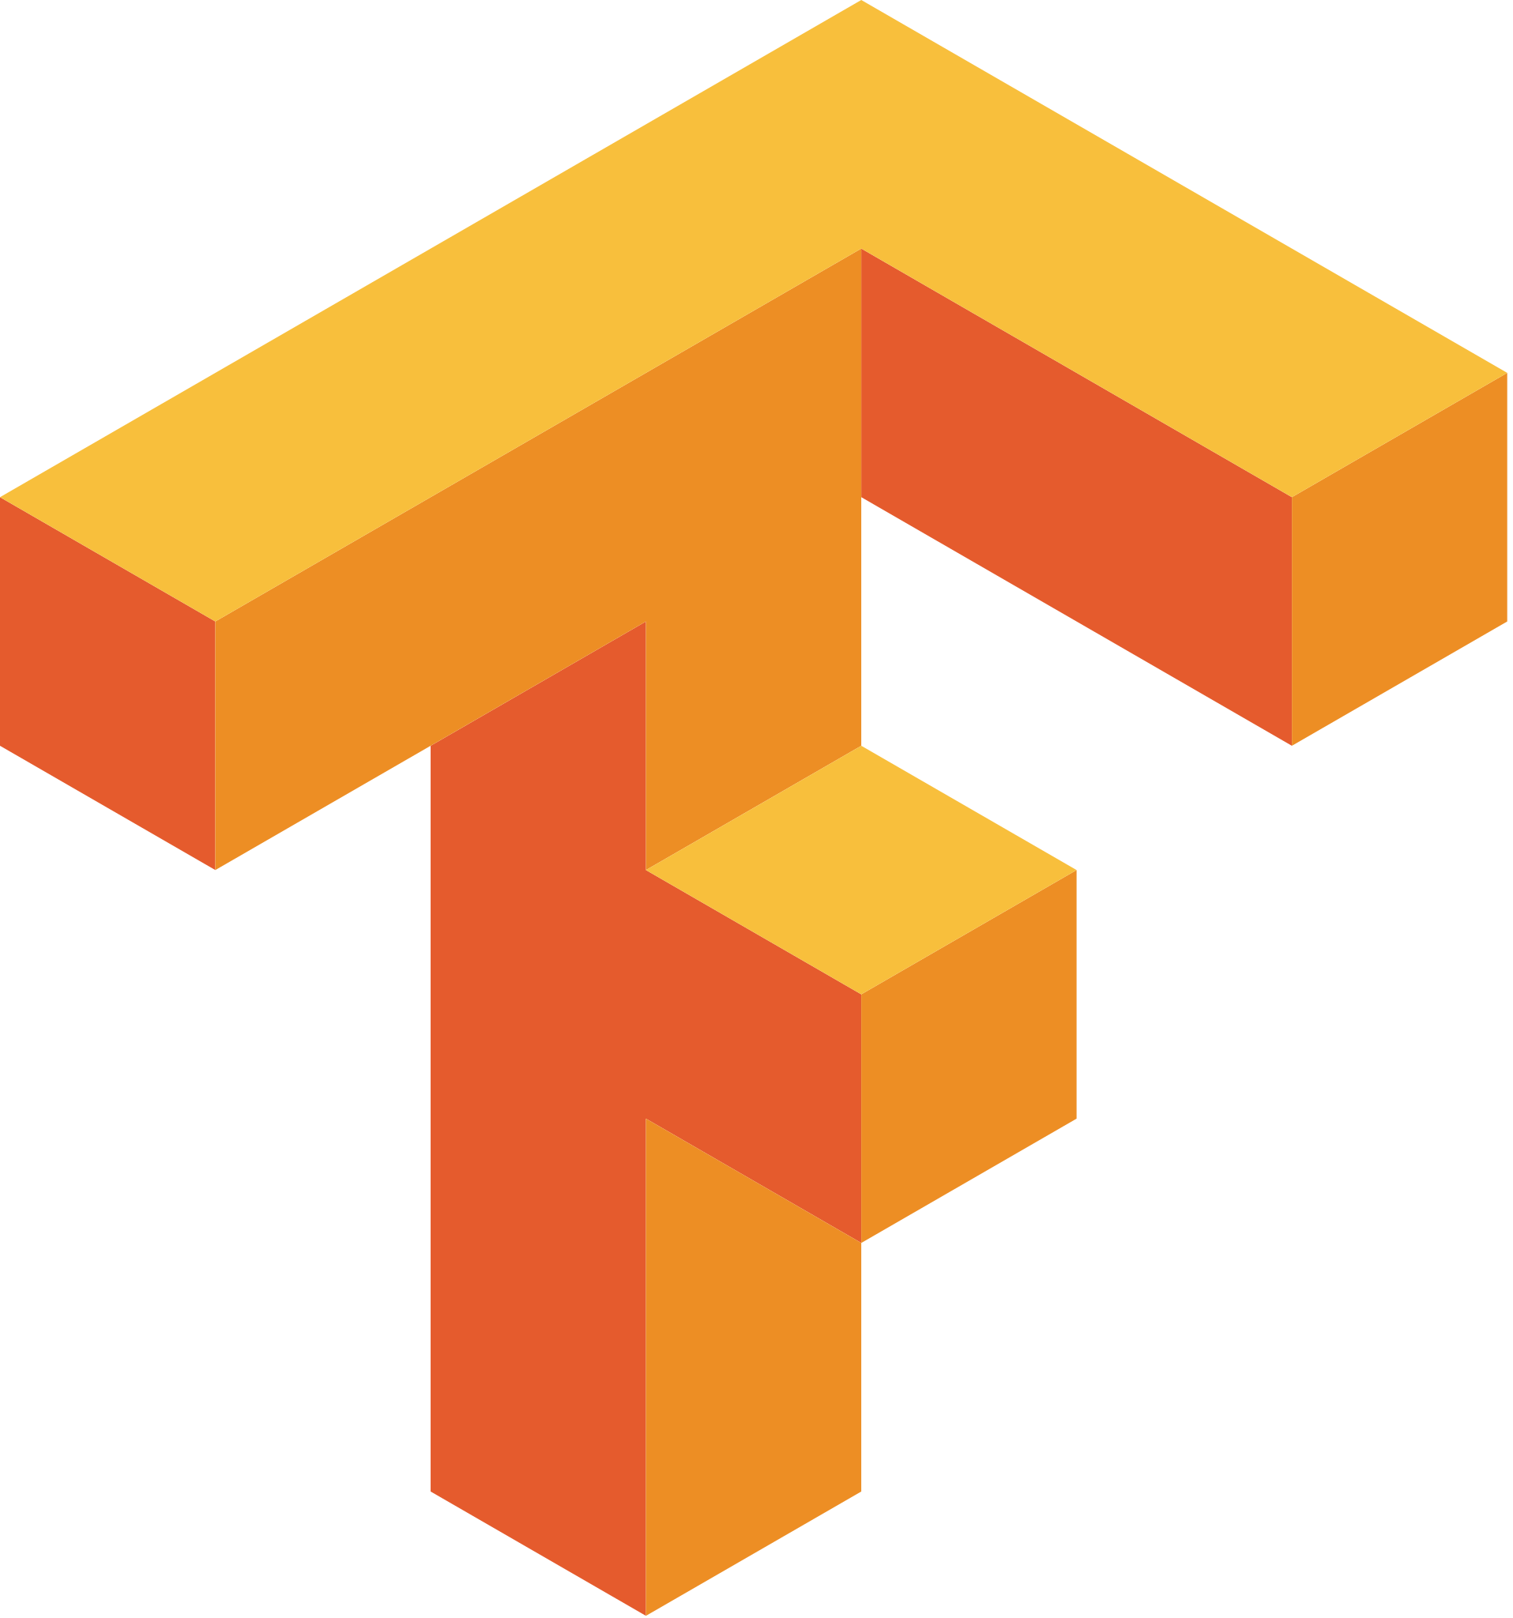
TensorFlow is a free and open-source software library for machine learning and artificial intelligence. It can be used across a range of tasks but has a particular focus on training and inference of deep neural networks.

Slide 25


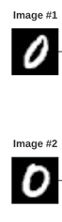
Tensor Flow
Keras
Image #1 Encodings
ConvNet
h(image1)
euclidean _distance(h1,h2)
sigmoid
0.98
Shared weights
similarity
ConvNet
h(image2)
Image #2 Encodings

Slide 26

Make your app the
best it can be
Firebase is an app development platform that helps you build and grow apps and games users love. Backed by Google and trusted by millions of businesses around the world.

Slide 27


Slide 28
Cloud Firestone
Real Time Database
Extension
Performance Monitoring
Authentication
Google Analytics
Hosting
Machine learning
Cloud Storage
Cloud Messaging

Slide 29

2023 Solution Challenge timeline

Slide 30

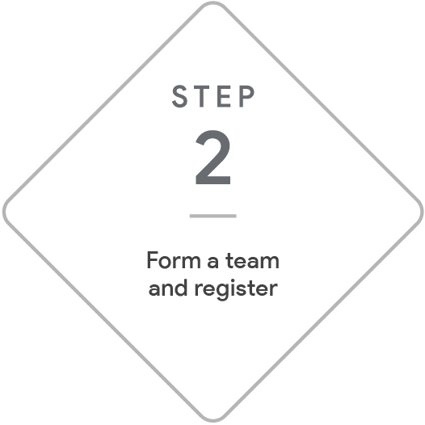



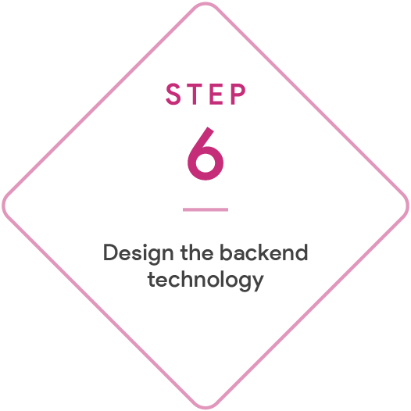



Top 3 winners
Win a $3,000 cash prize per team member and a feature in the Google Developers Blog and global Demo Day livestream, plus mentorship with a Google expert, swag, and a certificate.

Slide 31
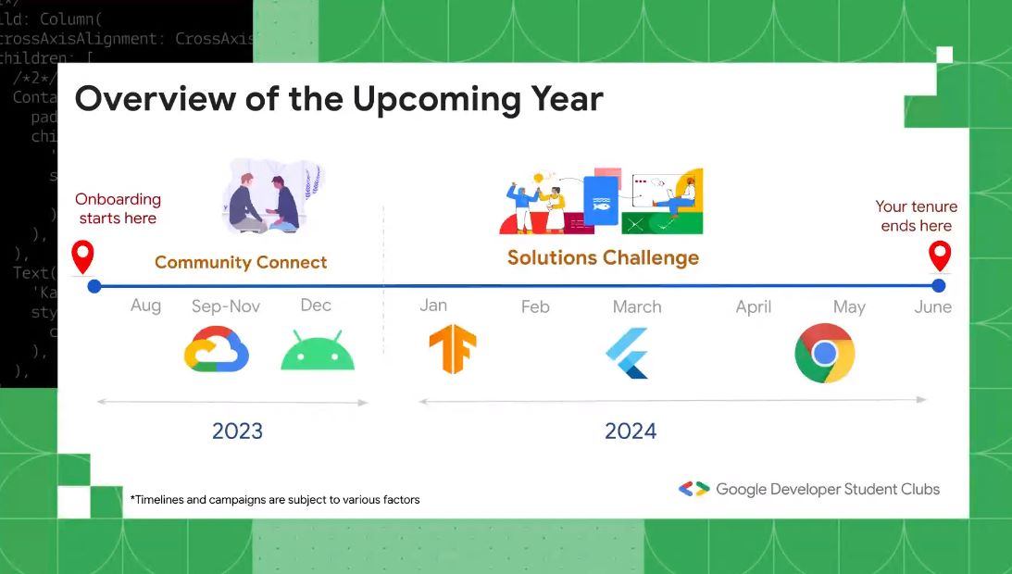
2020

Slide 32









Jai Mishra
Jiya Jindal
(Technical Team)
Vidushi Gandhi
(Technical Head)
Yashvinder
(Designer Head)
Hitesh Lamba
(Connectivity Team)
(Technical Team)
Shashwat Mishra
(Social media Head)
Himanshu Pal
(Management Team)
Gauri Panchal
(Management Team)
Nikhil
(Content Team)

Slide 33


Slide 34
Thank You !

